Slide 1


NatSteel Driver Training Program

Slide 2
Safety and Health Contact

Slide 3





NSH Driver PPE Requirement
SAFETY HELMET
安全帽
SAFETY SHOES
安全鞋
EAR PLUG
耳塞
SAFETY VEST
安全衣
SAFETY GLASSES
安全眼镜

Slide 4
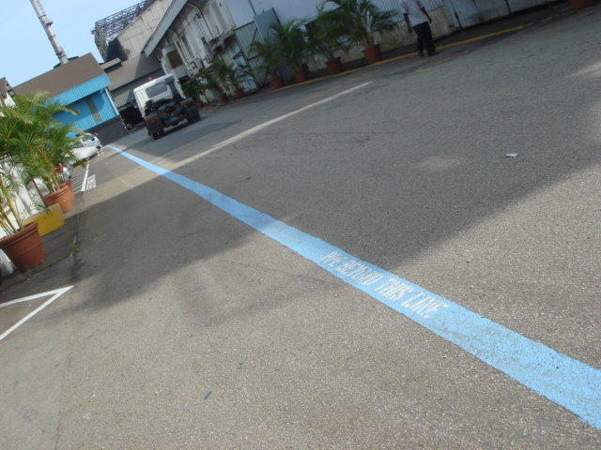
Personal Protective Equipment (PPE）
Please wear
1) Safety Helmet
2) Safety Glasses
3) Safety Shoes
4) Ear plugs
Once you want to cross the blue boundary line
Demarcation Line

Slide 5




Driver Wellness
Please Do Not Driver and Take Sufficient Rest
Over worked/Exhausted/Tired
Medication
Sick

Slide 6
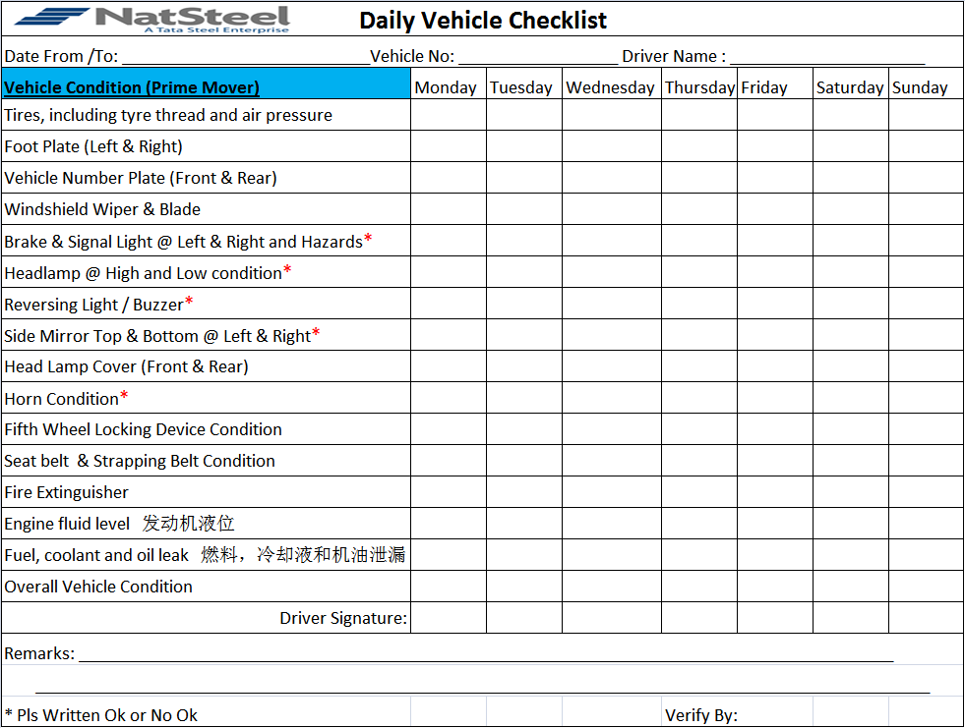
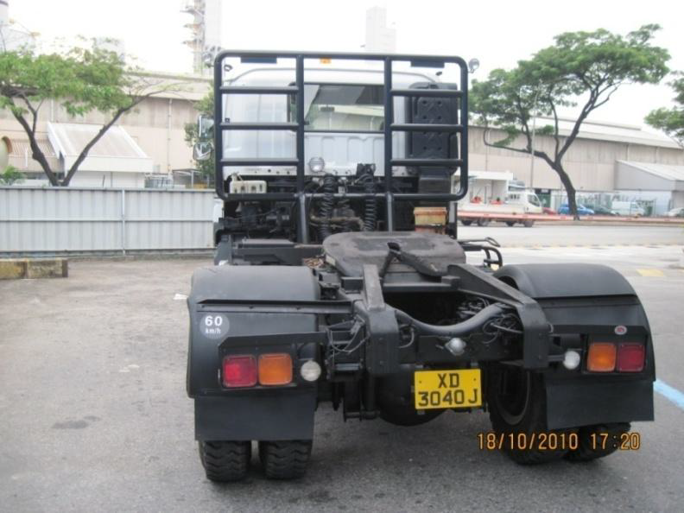
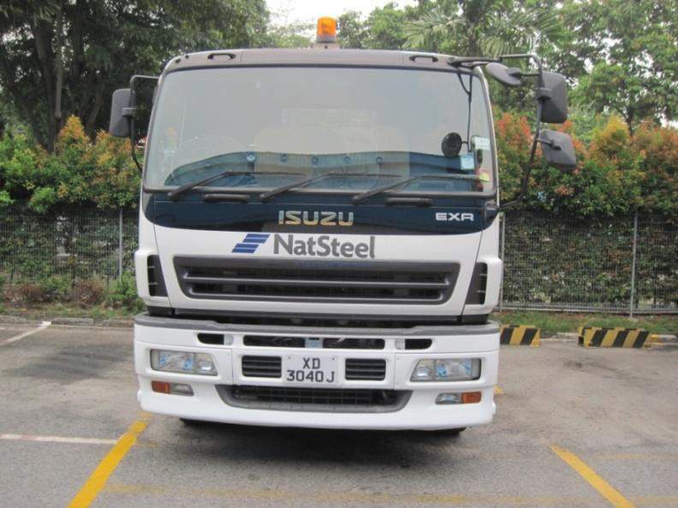
To comply with Prime mover Daily Pre operation Checklist
Safe Work Procedures

Slide 7
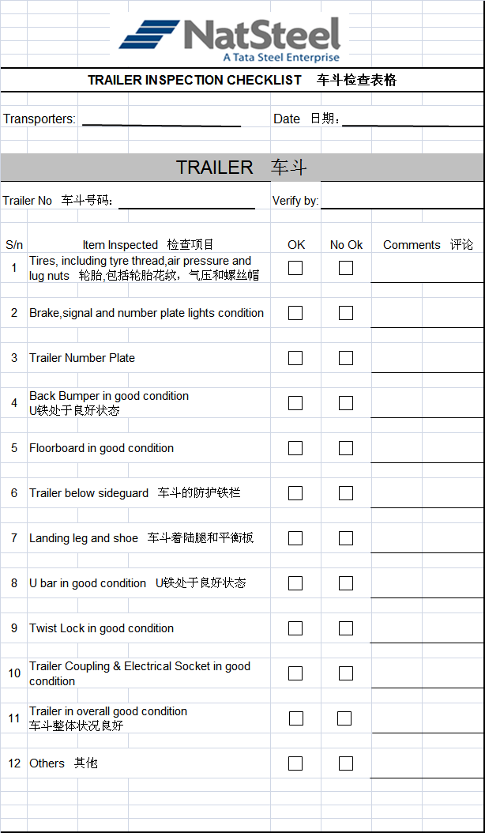
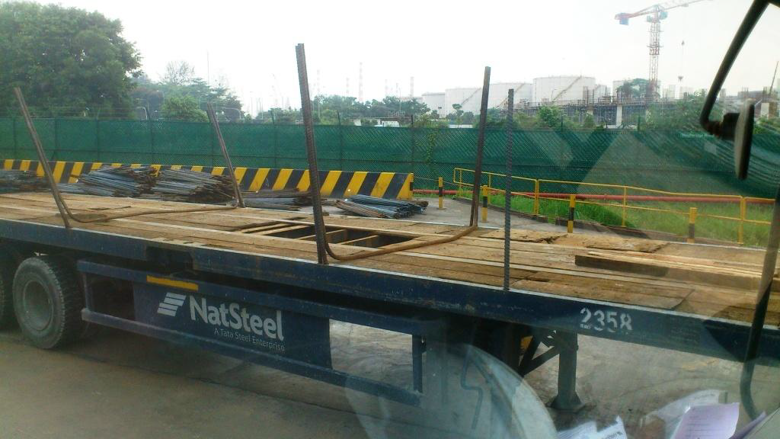
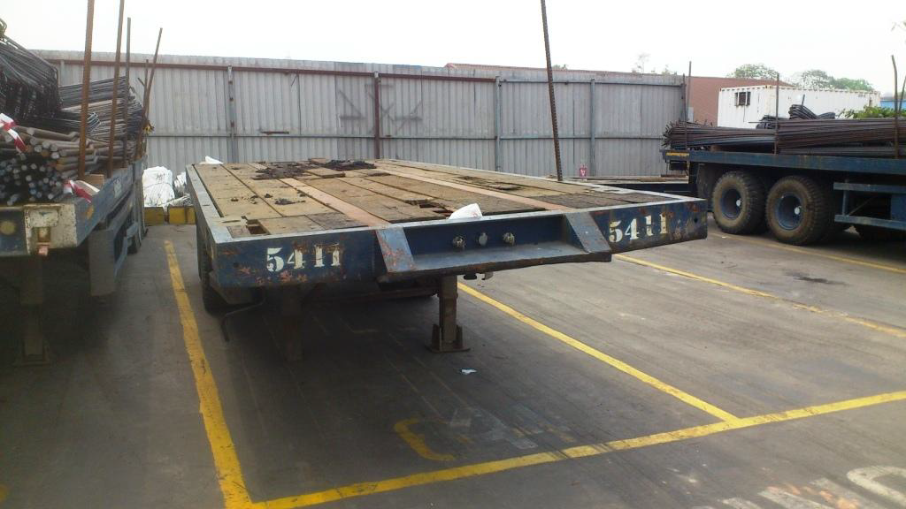
To comply with Trailer Daily Checklist
Safe Work Procedures

Slide 8
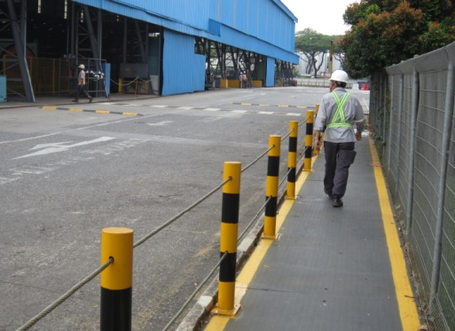
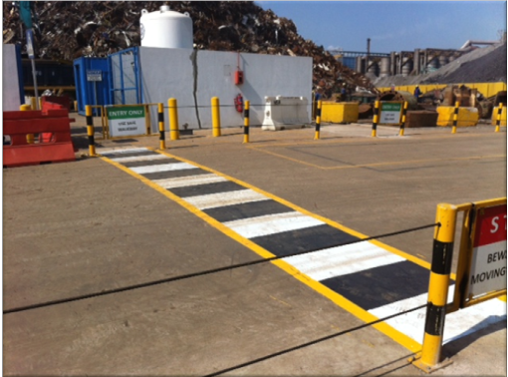
Safe Work Procedures
Use Safe Walkways
Use Pedestrian Crossings

Slide 9
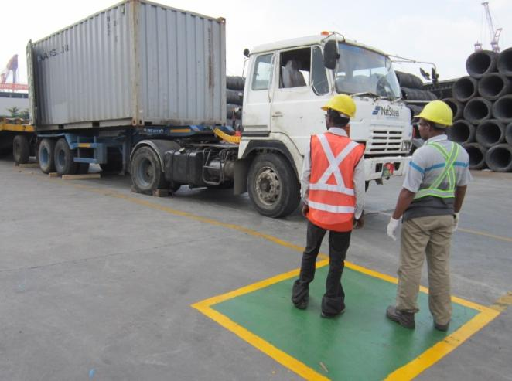
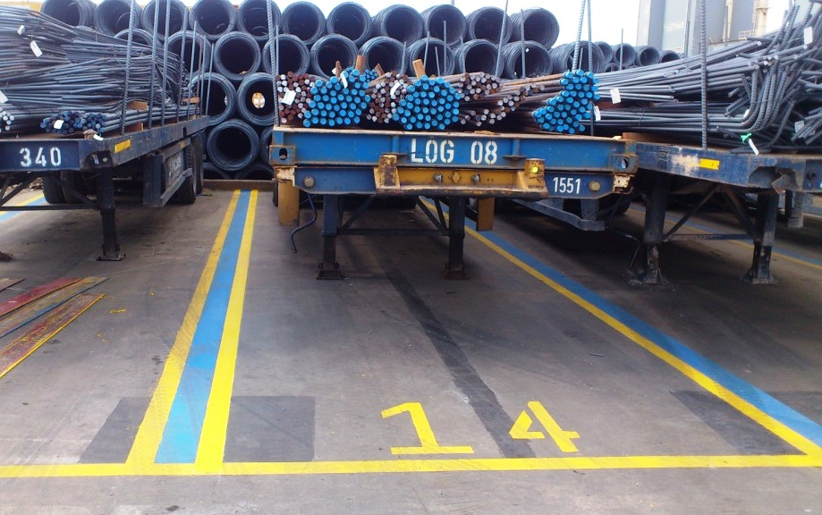
Safe Work Procedures
Waiting Only at Designated area
Parking only at Designated Trailer Parking Lots

Slide 10
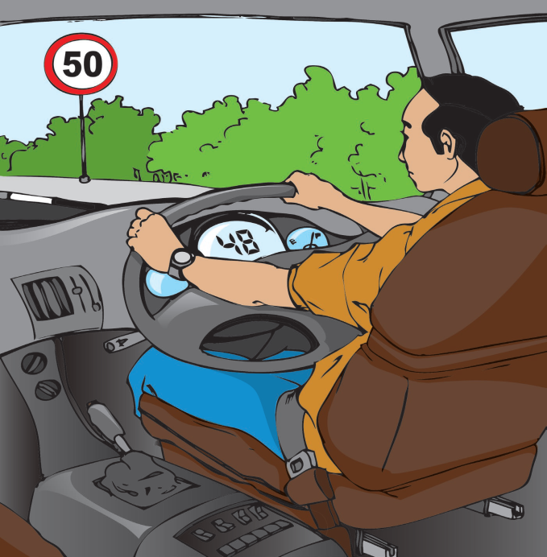
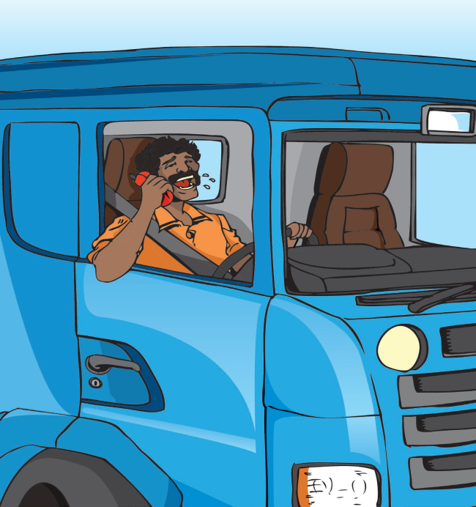
Safe Work Procedures
Drive within Speed Limits -> 20Km/Hr
Do Not Use Mobile Devices While Driving

Slide 11
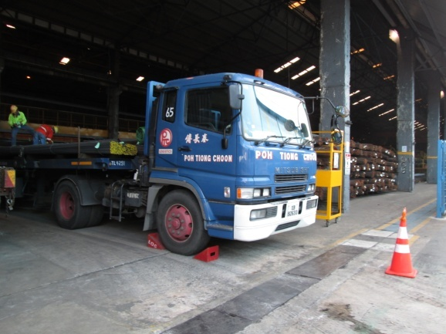
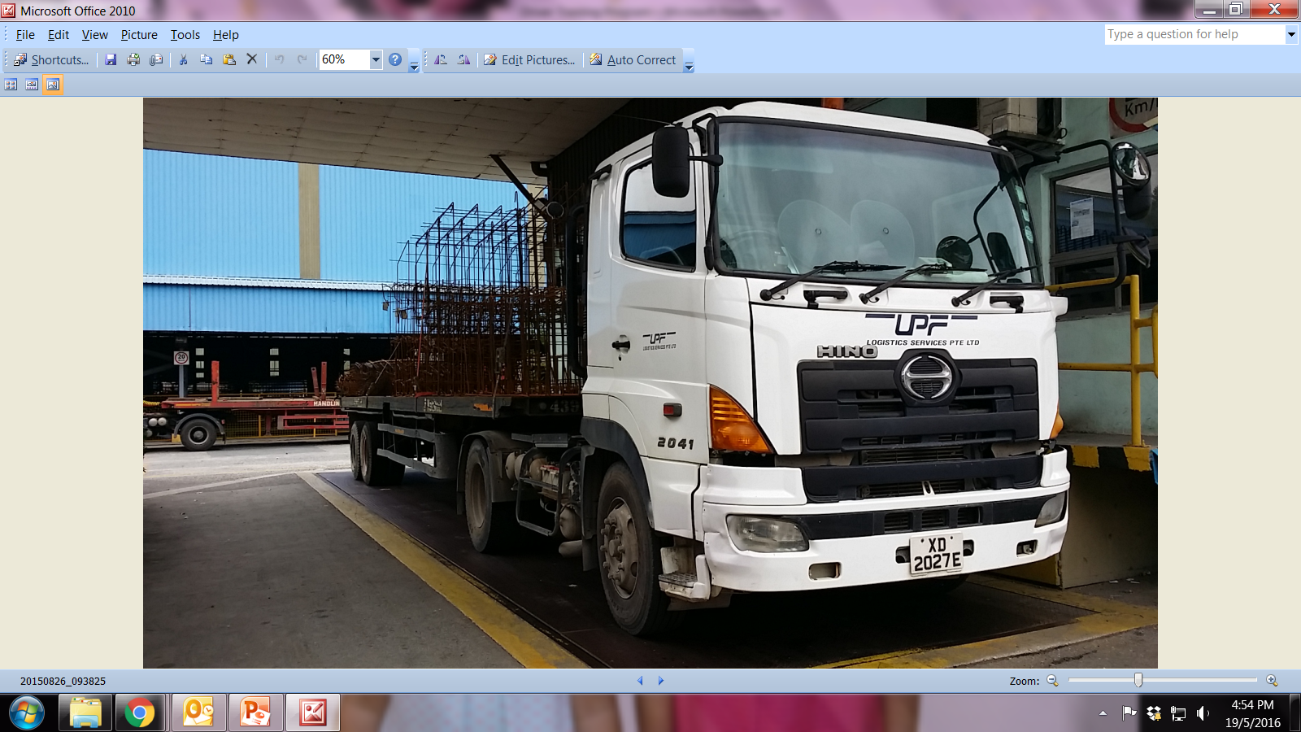
Safe Work Procedures
OFF Engine and Apply Wheel choke at Loading/unloading bay
OFF Engine at Weighing Bridge

Slide 12
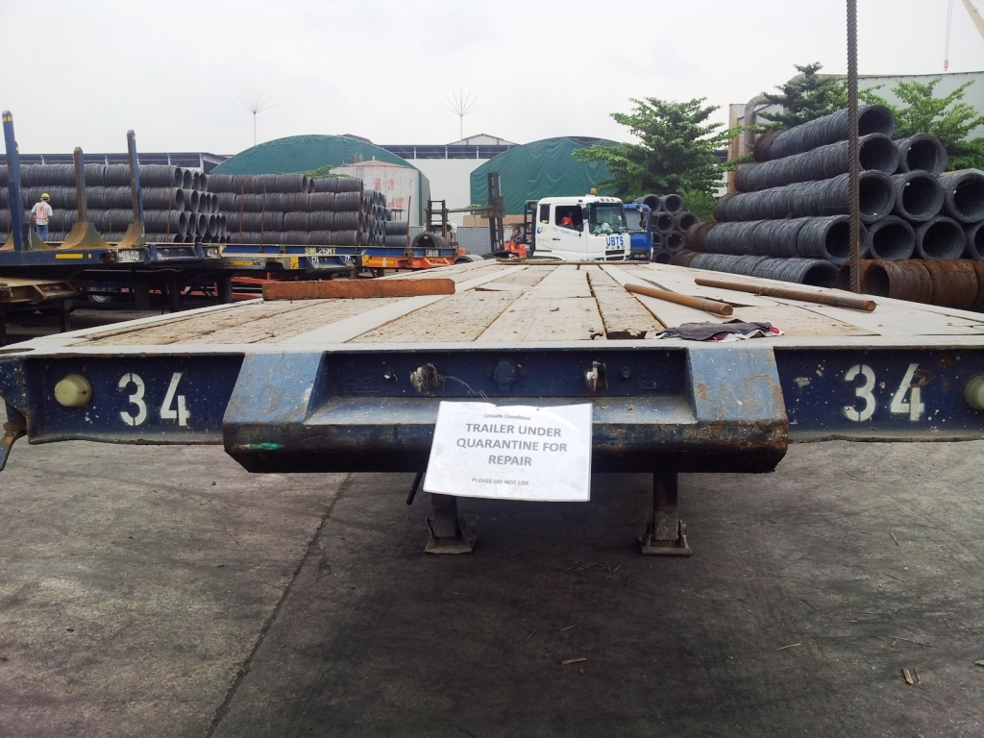
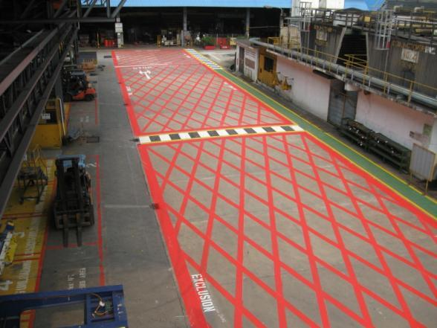
Safe Work Procedures
Do Not Use Damaged Trailers
Do not park at Exclusion zones

Slide 13
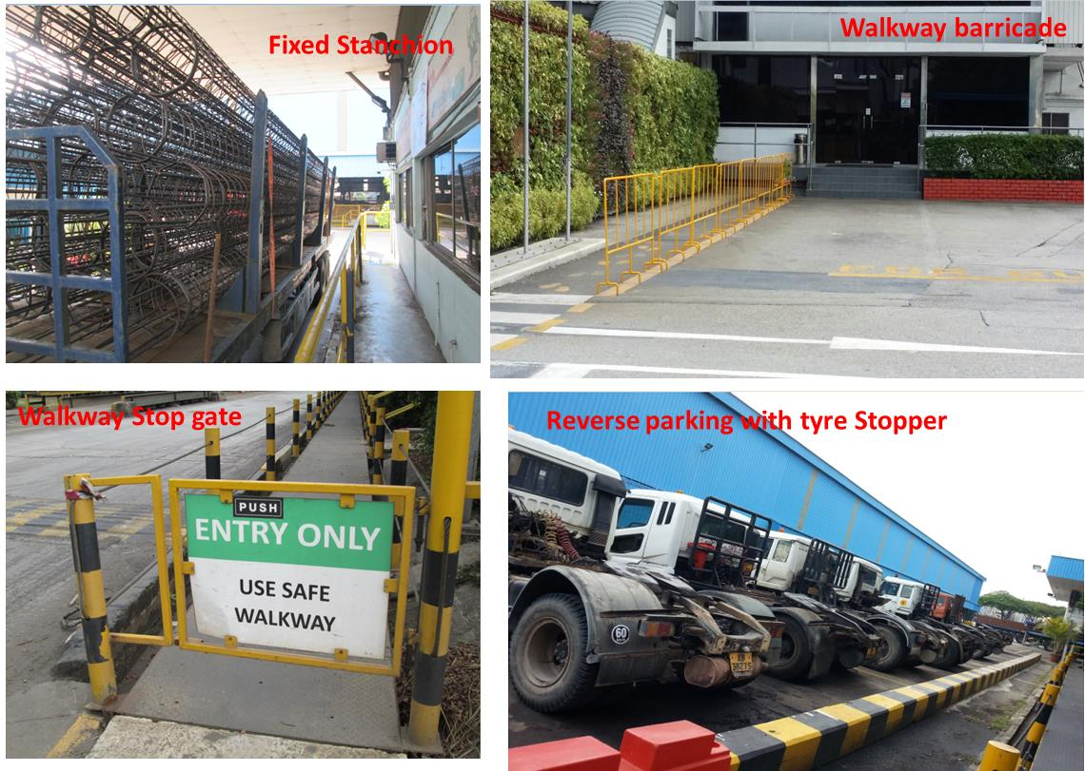
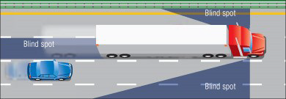
Safe Work Procedures
Comply with Reverse Parking and Horn Before Reversing
Beware of Blind Spot

Slide 14
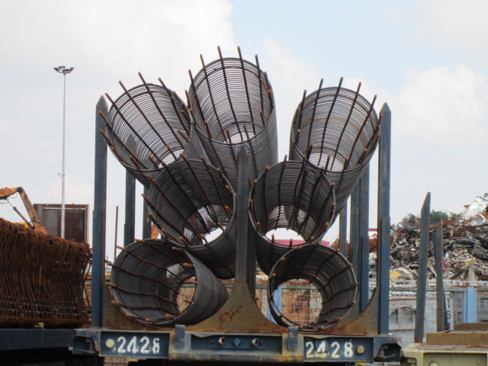
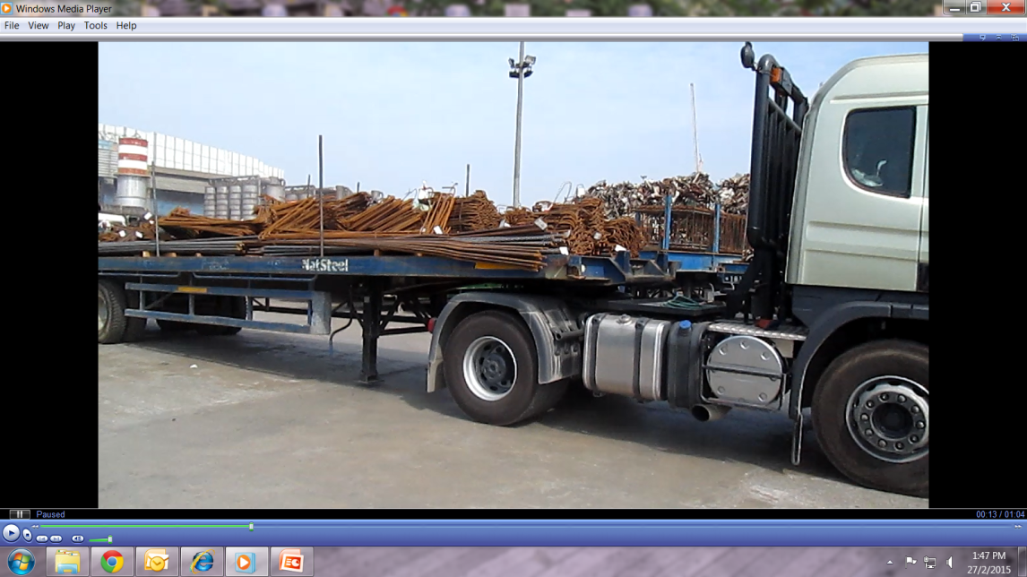
Safe Work Procedures
Do Not Exceed Load Height Limit
3.2m
Be Vigilant During Trailer Coupling/Decoupling

Slide 15
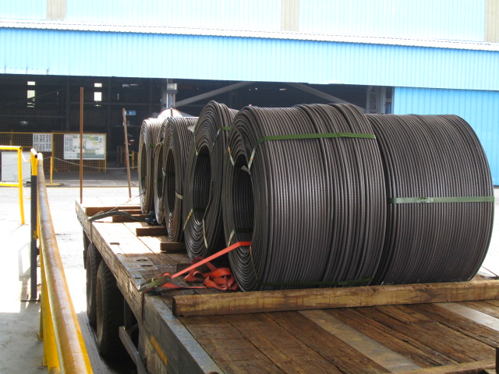
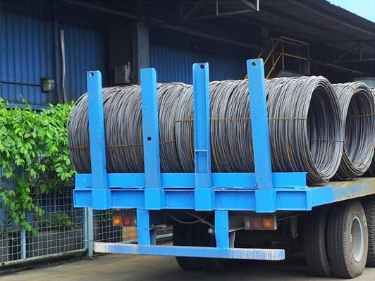
Safe Work Procedures
Apply Wooden Choke for Each Coil & Lashing on Front and Rear Coils
Install Rear Support for Coils

Slide 16
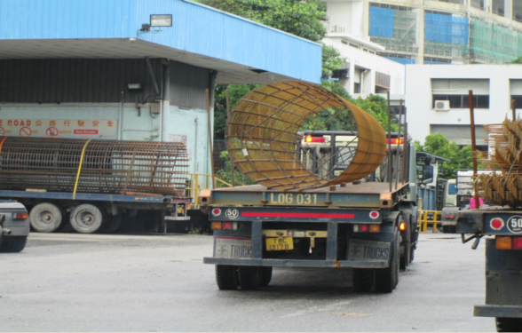
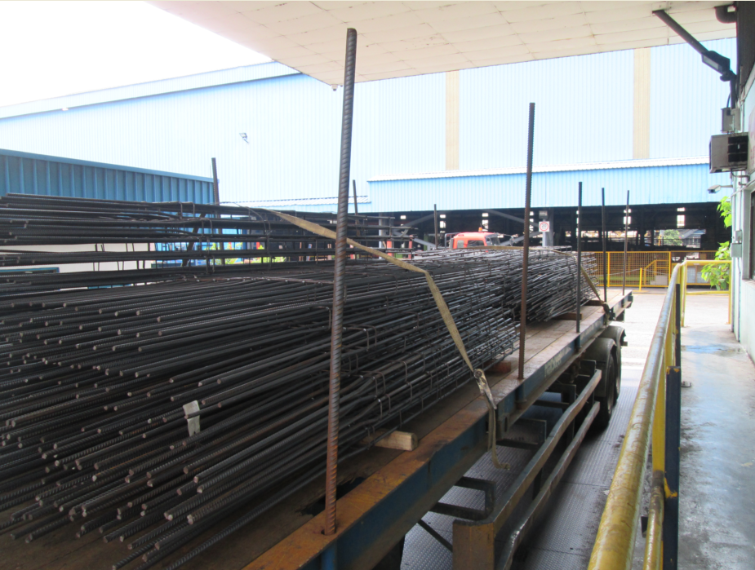
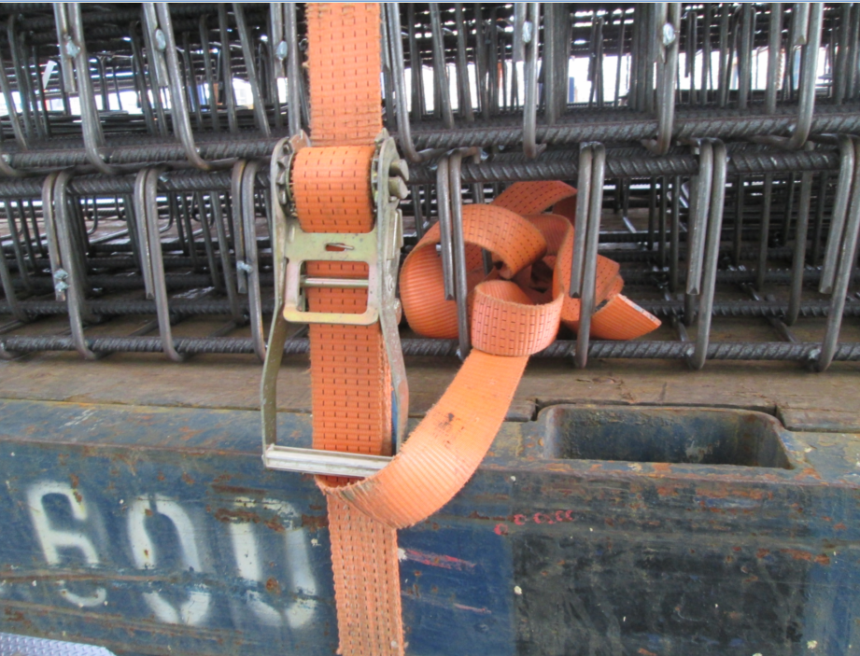
Safe Work Procedures
Lashing
Normal Condition - Minimum 2
Big Diameter Cage – Minimum 3
Install Rear Stanchion and Lashing
Secure Lashing Device
Stanchions
40Ft Trailer – 4 Each Side
20Ft Trailer – 2 Each Side

Slide 17
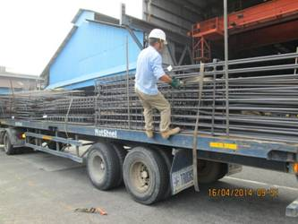
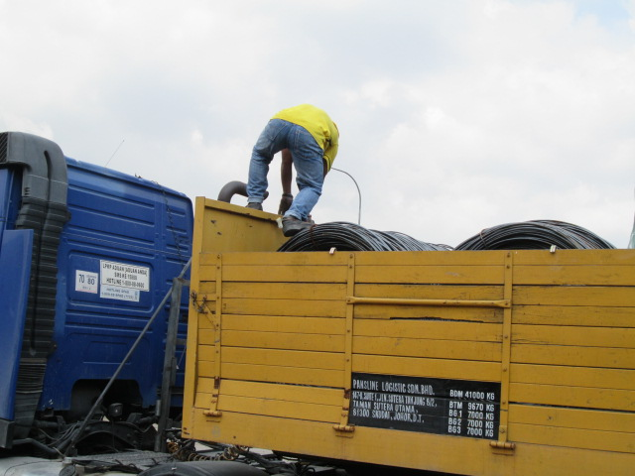
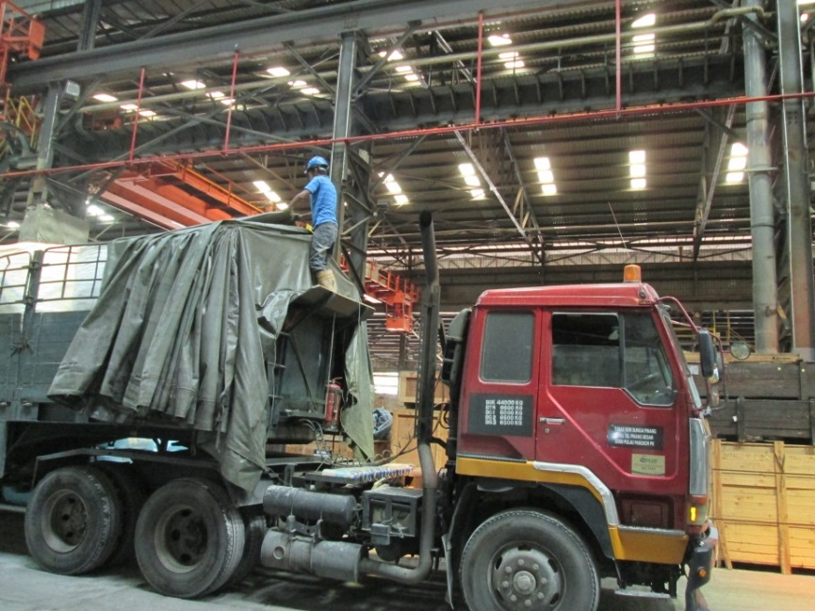
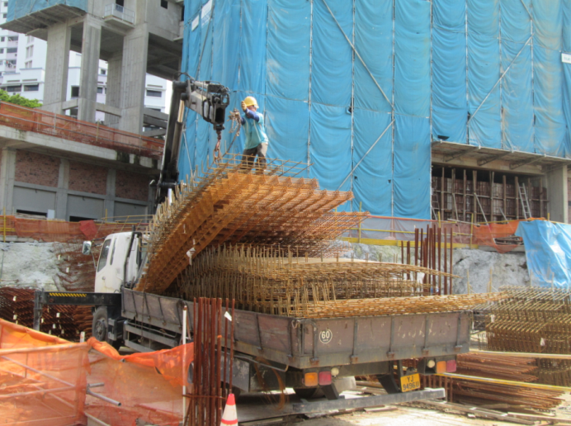
Safe Work Procedures
Use Ladder/Movable Platform
Do Not Climb Like This!!

Slide 18
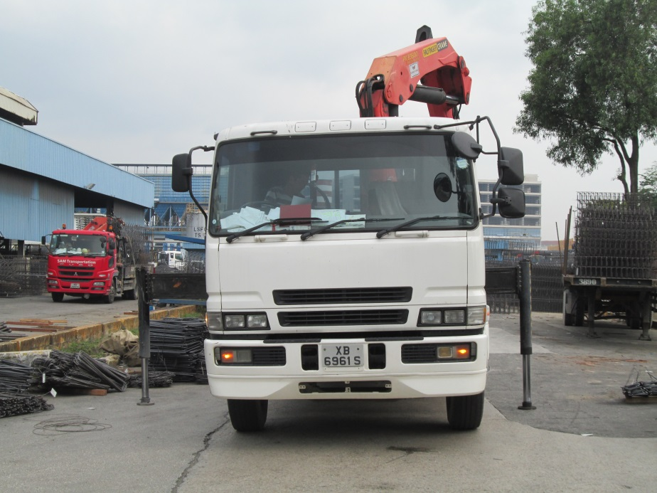
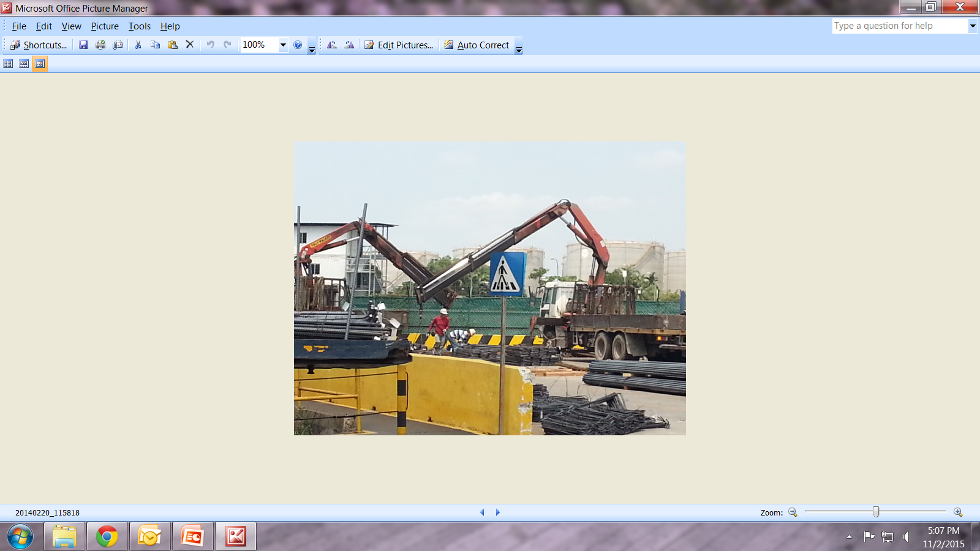
Safe Work Procedures
Outriggers Should be Fully Extended
Eliminate Dangerous Lifting Activities

Slide 19
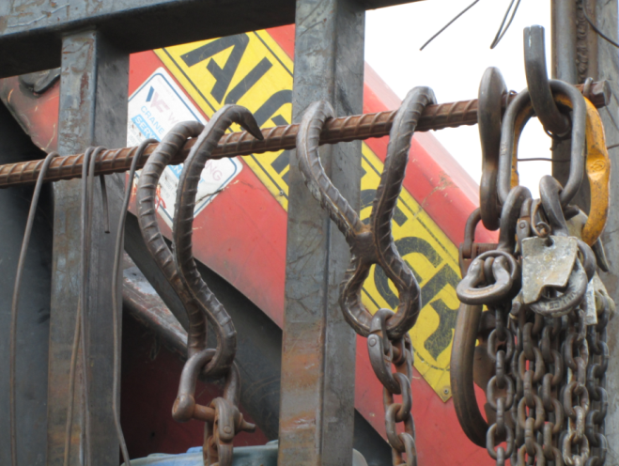
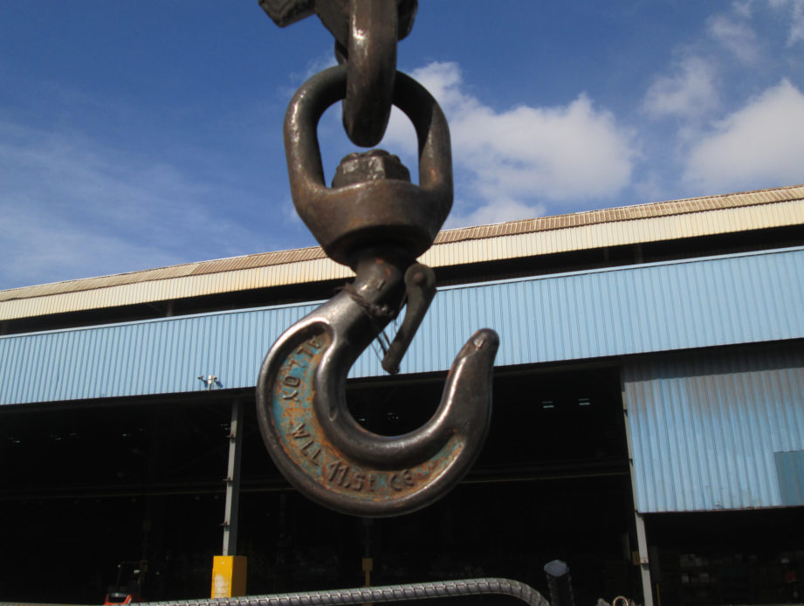
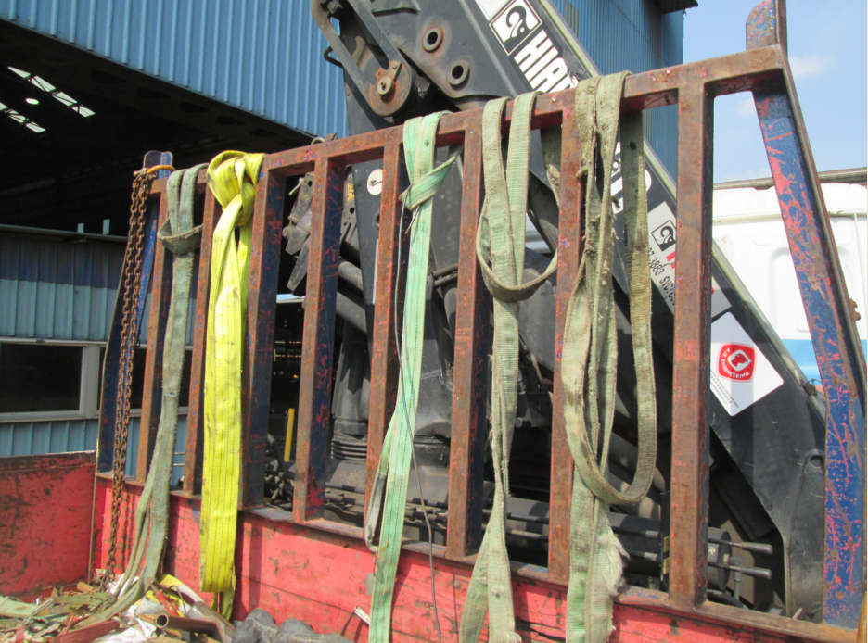
Safe Work Procedures
Lifting Gears Must Have Valid MOM Certification
Do Not Bypass Safety Devices
Do Not Use Self made Hooks
Do Not Use Damaged Lifting Gears

Slide 20
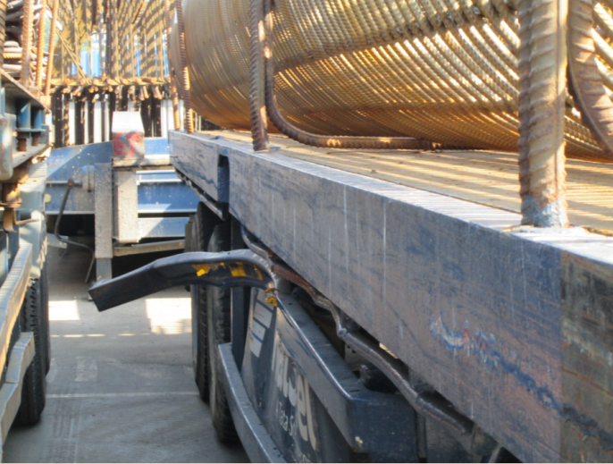
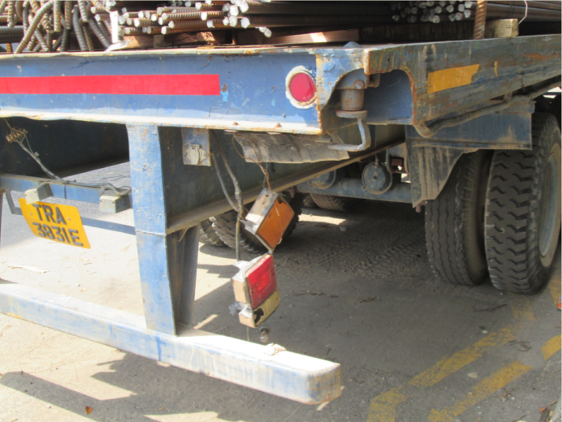
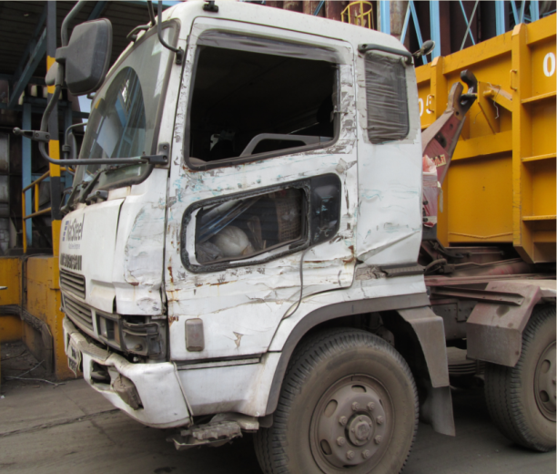
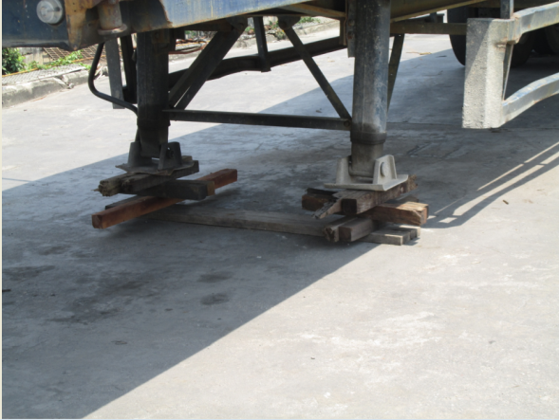
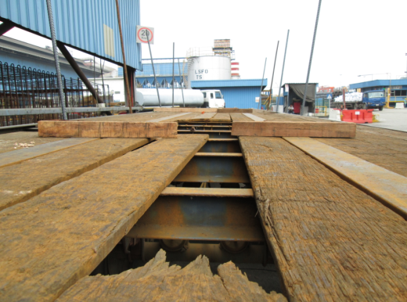
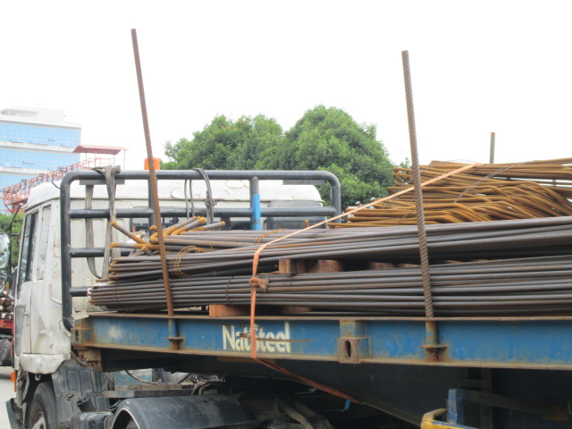
Safe Work Procedures
Do Not Use Damaged Vehicle/Trailer/Lashing
Damaged Side Guards
Damaged Lights
Damaged Doors
Damaged Landing Leg
Damaged Trailer Board
Damaged Lashing

Slide 21
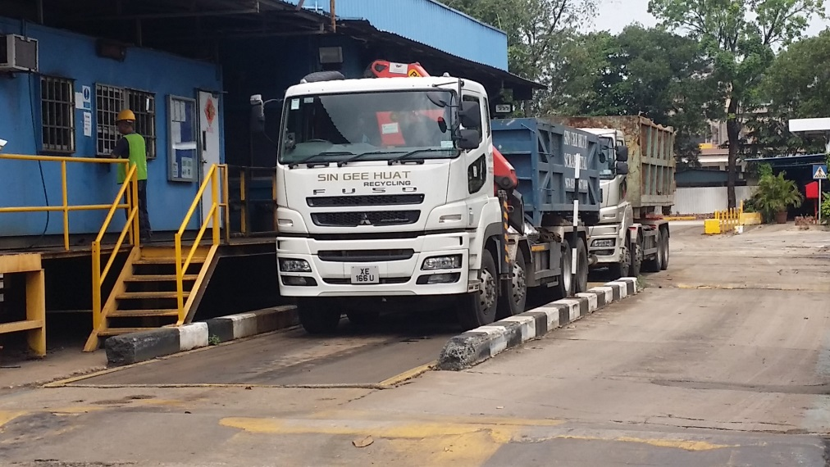
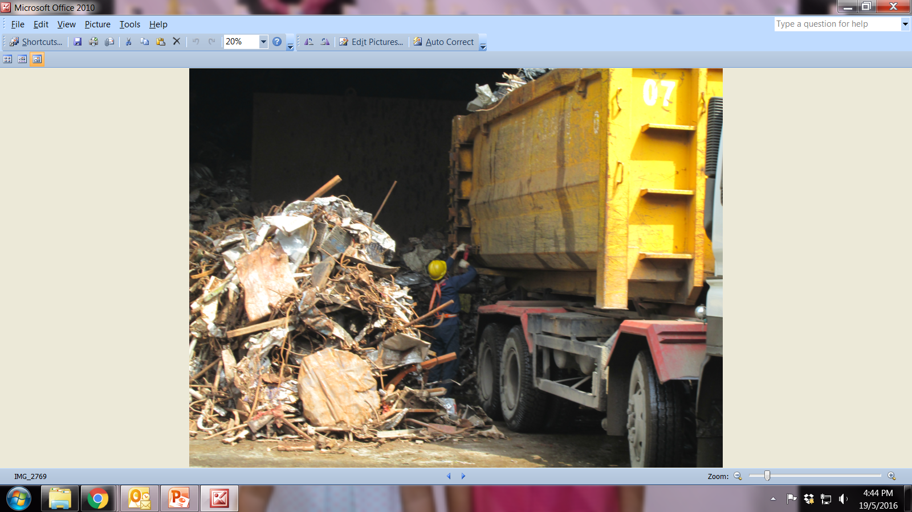
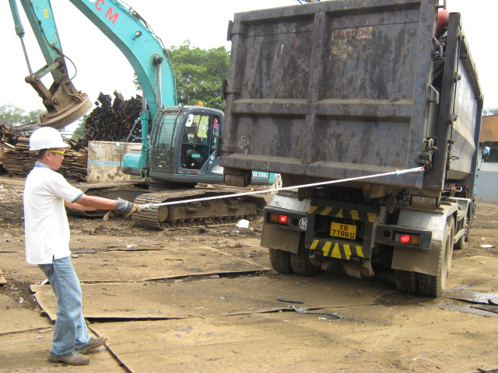
Safe Work Procedures
Be Vigilant and Hold Handrail
Keep Clear of Scrap Piles
Beware! Gap in Between Truck and Platform
Use Tagline to Open Door

Slide 22
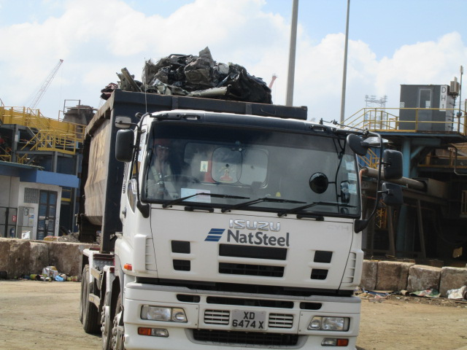
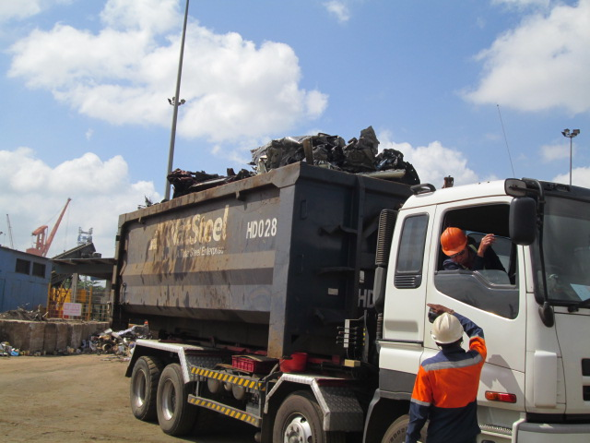
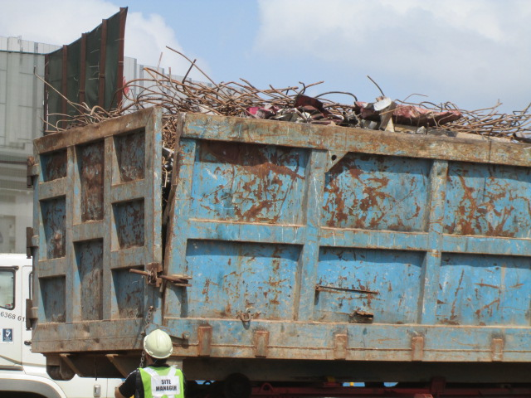
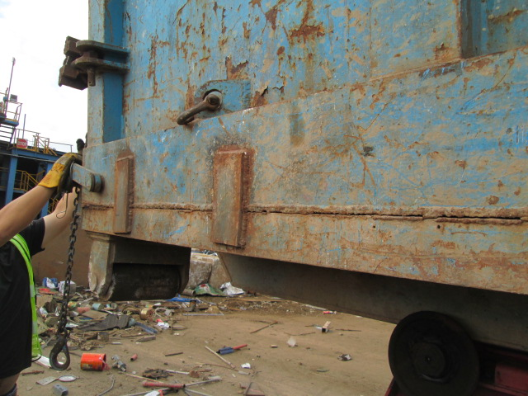
Safe Work Procedures
Do Not Overload Scrap Truck
Do Not Use Damaged Bin

Slide 23
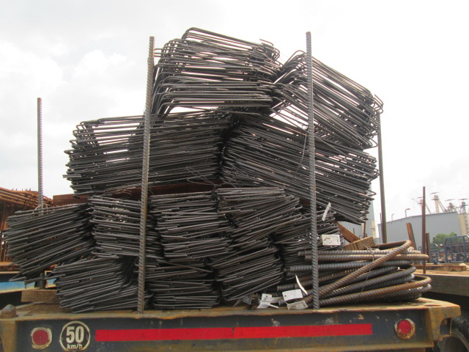
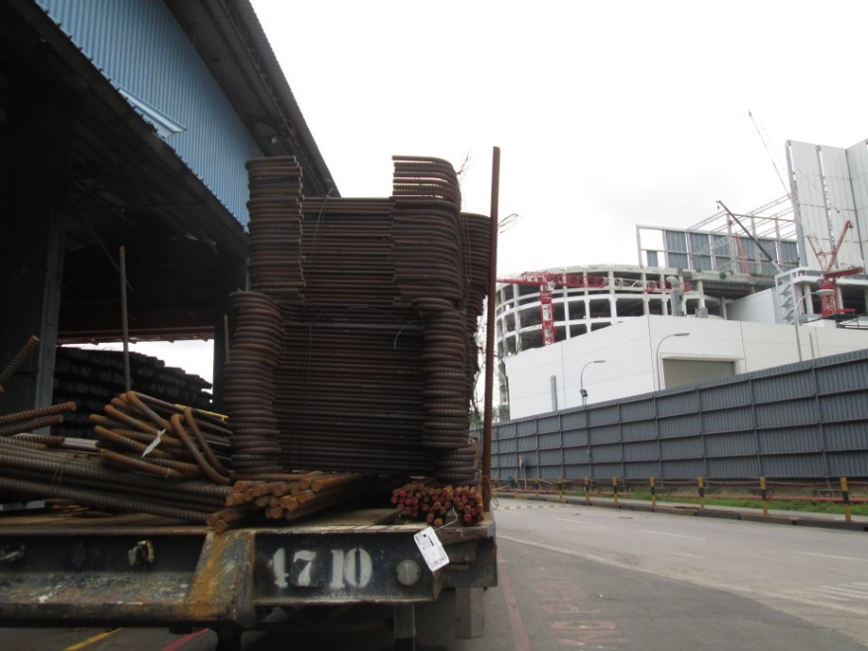

Safe Work Procedures
Do Not Engage with Unstable Loads

Slide 24




Safe Work Procedures
Strictly Comply Safe Work Procedures to Eliminate Incidents

Slide 25





NSH Consequence Management System

Slide 26
Thank you for your kind attention
Follow Safe Work Procedures
&
Go Home Safely

